Slide 1

  CMC
  Unit V
PRESENTATION
BY
VIDYA SAGAR

Slide 2
UNIT – V
HANDOFFS AND DROPPED CALLS
Handoffs initiation, Types of handoff, Delaying handoff, Advantages of handoff, Power difference handoff, Forced handoff, Mobile assisted and soft handoff. Intersystem handoff, Introduction to dropped call rates and their evaluation.

Slide 3
Handoff Strategies
Handoff: a mobile user moves to a different cell while conversation is in progress, MSC transfers the call to a new BS.
  Identifying new BS
  New voice and control channels to be allocated
Handoff must be performed
  Successfully
  Infrequently
To achieve this, designer must specify optimum signal level at which handoff initiates
vidya sagar

Slide 4
Need of Handoff?
Power Consideration
Traffic Consideration
Channel Quality Consideration
Distance Consideration
Administrative Consideration
vidya sagar

Slide 5
Once, a signal level is specified as min usable level for acceptable voice quality
  A slightly stronger signal level is used as threshold
  Normally taken between -90 dBm and -100 dBm.
This margin ∆ = Pr_handoff – Pr_min, can not be too large or too small
  If ∆ is too large, unnecessary handoffs, burden on MSC
  If ∆ is too small, insufficient time to complete a handoff before a call is lost due to weak signal
  ∆ should be chosen carefully to meet conflicting requirements
vidya sagar

Slide 6
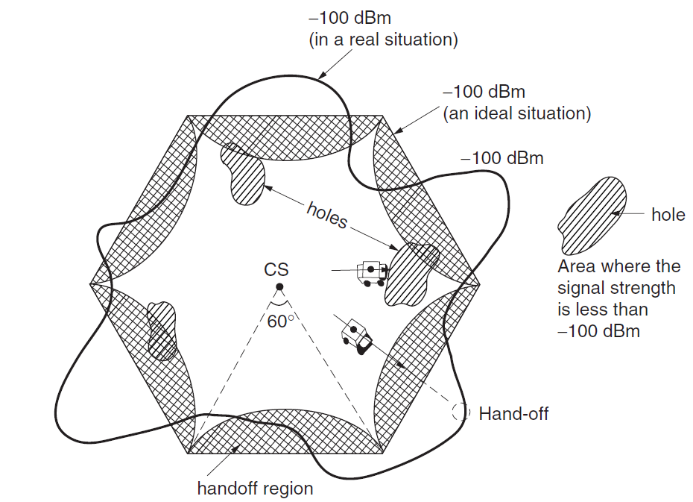

Slide 7
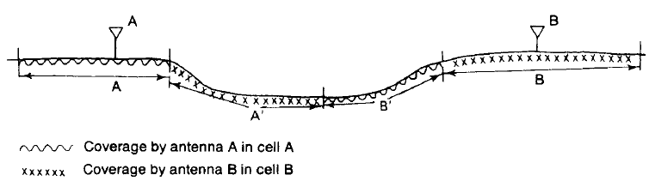
Signal Coverage Cells

Slide 8
Handover decision
receive level
BTS_{old}
receive level
BTS_{new}
HO_MARGIN
MS
MS
BTS_{old}
BTS_{new}
vidya sagar
<number>(#)

Slide 9
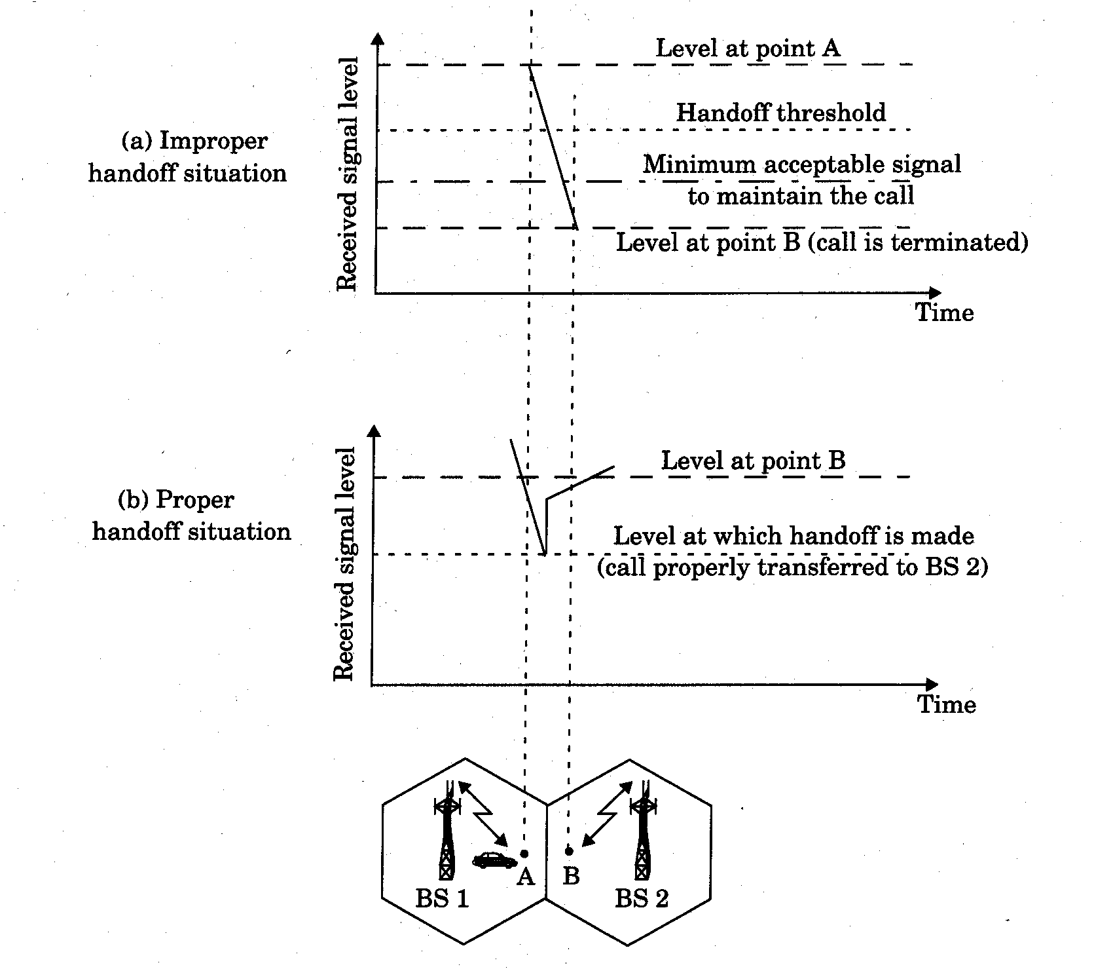
vidya sagar
<number>(#)

Slide 10
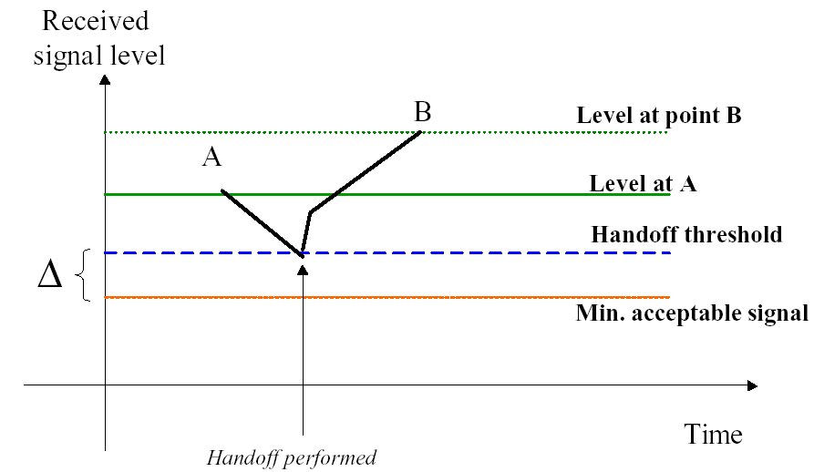
CASE 1: Handoff - Successful
Value of delta is large enough. When the P_{Handoff} is reached, the MSC initiates the handoff.
vidya sagar
Notes:
Value of delta is large enough. When the Phandoff is reached, the MSC initiates the handoff.

Slide 11
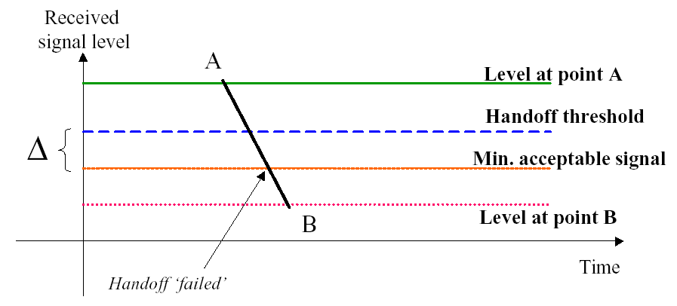
CASE:2 Handoff - Unsuccessful
In this case, the MSC was unable to perform the handoff before the signal level dropped below the minimum usable level, and so the call was lost.
vidya sagar
Notes:
In this case, the MSC was unable to perform the handoff before the signal level dropped below the minimum usable level, and so the call was lost.

Slide 12
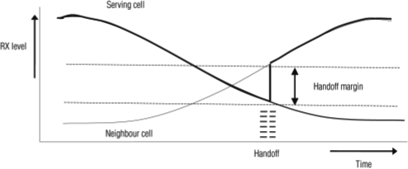
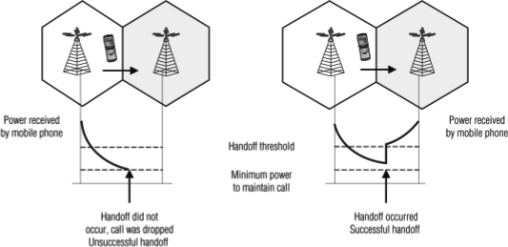
vidya sagar

Slide 13
Handoff – Unsuccessful (cont’d)
Reasons for failed handoff:
  ∆ too small (i.e. P_{HANDOFF} too low)
  high mobile speeds
  Excessive delay at MSC
    High traffic level
    Un-availability of channels
vidya sagar

Slide 14
Dwell time
The length of needed monitoring largely depends on the speed of mobile units.
Dwell time: the amount of time over which a call may be maintained within a cell without handoff.
The statistics of dwell time, vary greatly depending on the type of radio coverage and user profiles within a cell, are important in the practical design of handoff algorithms.
vidya sagar

Slide 15
Two Decision-Making Parameters of Handoff
Based on
  signal strength
  carrier-to-interference ratio
Type -1
the signal-strength threshold level for handoff is
−100 dBm – noise-limited systems
−95 dBm – interference-limited systems
Location receiver at each cell site
Received signal strength (RSS)
RSS = C + I
Two situations may occur
  I more
  I Less
Not accurate

Slide 16

Type -2
C/I at the cell boundary for handoff should be at a level, 18 dB
Carrier to Interference Ratio
Two situations occur
  C Less
  I more

Slide 17
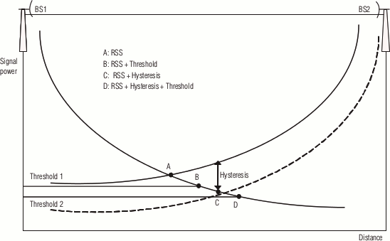
Relative signal strength with hysteresis and threshold
vidya sagar

Slide 18
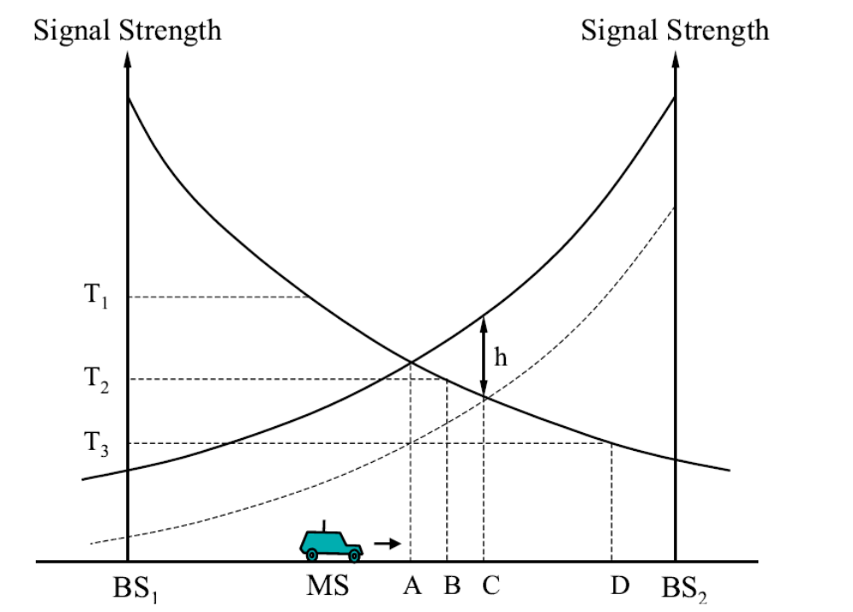
vidya sagar

Slide 19
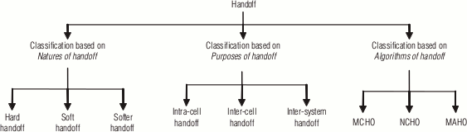
Handoff scenarios
Depending on the BS and MSC arrangement of the cellular network the handoff may occur in the following scenarios, based on the movement of a mobile station (MS).
vidya sagar

Slide 20
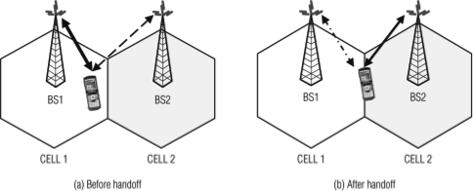
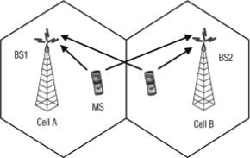
Classification based on natures of handoff
In this classification, the handoff mechanism is usually categorized as follows:
Hard handoff : A hard handoff is also known as break-before-make handoff.
Soft handoff : The soft handoff is also known as make-before-break handoff.
Soft handoff between BS1 and BS2
vidya sagar

Slide 21
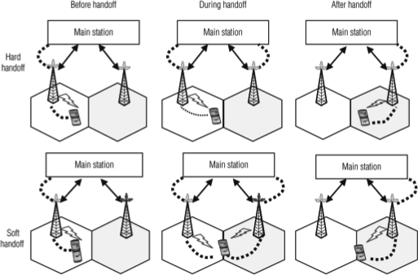
Comparison of hard handoff and soft handoff
vidya sagar

Slide 22
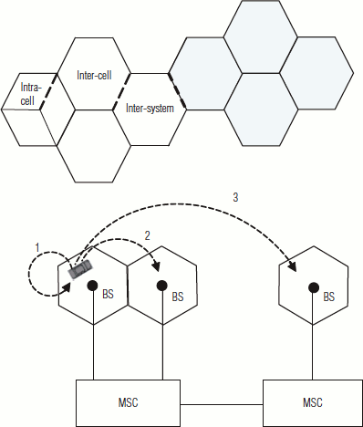
Classification based on purposes of handoff
In this classification the handoff can be of three types: intra-cell handoff, inter-cell handoff, and inter-system handoff.
vidya sagar

Slide 23
Handoff schemes based on algorithms of handoff (handoff protocols)
Three strategies have been proposed to detect the need for handoff:
MCHO (mobile-controlled handoff)
NCHO (network-controlled handoff)
MAHO (mobile-assisted handoff)
vidya sagar

Slide 24
Mobile‑Controlled Handoff (MCHO)
The MS continuously monitors the signals of the surrounding BSs and initiates the handoff process when some handoff criteria are met.
MCHO is used in DECT and PACS.
Digitally Enhanced Cordless Telecommunications system
Personal Access Communication System
vidya sagar
<number>(#)

Slide 25
Network‑Controlled Handoff (NCHO)
The surrounding BSs measure the signal from the MS, and the network initiates the handoff process when some handoff criteria are met.
NCHO is used in CT‑2 Plus and AMPS.
vidya sagar
<number>(#)

Slide 26
Mobile‑Assisted Handoff (MAHO)
The network asks the MS to measure the signal from the surrounding BSs. The network makes the handoff decision based on reports from the MS.
MAHO is used in GSM and IS‑95 CDMA.
vidya sagar
<number>(#)

Slide 27
INITIATION OF HANDOFF
Signal strength - reverse voice channel
Threshold level - minimum required voice quality
Cell site – MTSO
Unnecessary Handoff
Failure Handoff

Slide 28
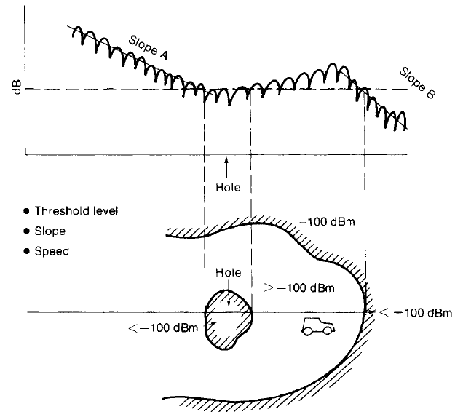

Slide 29
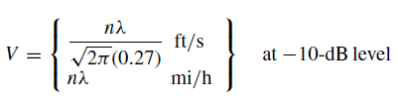
The velocity of vehicle V and the pathloss slope γ , can be used to determine the value of Δ dynamically

Slide 30
Two circumstances where handoffs are necessary but cannot be made
When the mobile unit is located at a signal-strength hole within a cell but not at the boundary
When the mobile unit approaches a cell boundary but no channels in the new cell are available.

Slide 31
DELAYING A HANDOFF
A Two-Level Handoff Algorithm
Advantage of Delayed Handoffs
  Switching processor
  Interference

Slide 32
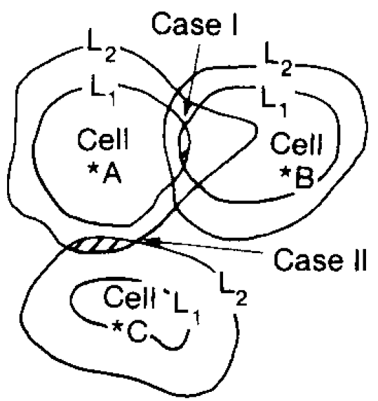

Slide 33
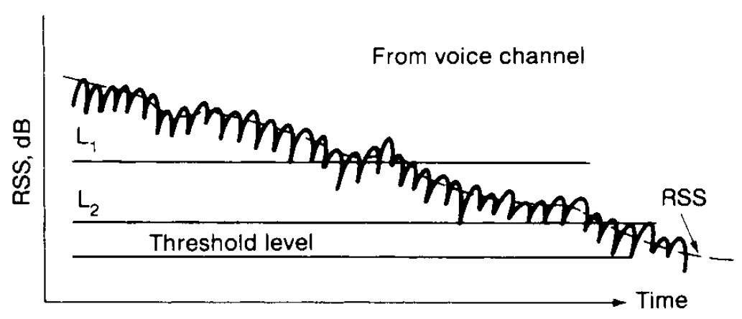

Slide 34
FORCED HANDOFFS
A forced handoff is defined as a handoff that would normally occur but is prevented from happening, or a handoff that should not occur but is forced to happen.

Slide 35
QUEUING OF HANDOFFS
Queuing of handoffs is more effective than two-threshold-level handoffs
1/μ - average calling time in seconds, including new calls and handoff calls in each cell
λ1 - arrival rate (λ1 calls per second) for originating calls
Λ2 - arrival rate (λ2 handoff calls per second) for handoff calls
M1- size of queue for originating calls
M2 -size of queue for handoff calls
N- number of voice channels
a =(λ1 + λ2)/μ
b1 =λ1/μ
b2= λ2/μ

Slide 36


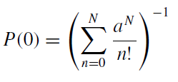

Case – 1
No queuing on either the originating calls or the handoff calls
The blocking for either an originating call or a handoff call is

Slide 37


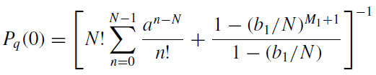



Case-2
Queuing the originating calls but not the handoff calls
The blocking probability for originating calls is
The blocking probability for handoff calls is

Slide 38


Case-3
Queuing the handoff calls but not the originating calls

Slide 39

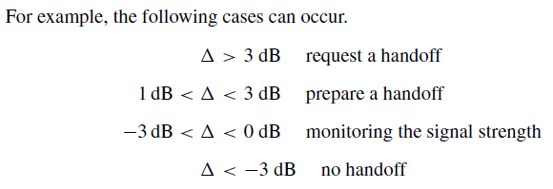
POWER-DIFFERENCE HANDOFFS
power difference (∆)

Slide 40
Handover Performance Metrics
Cell blocking probability – probability of a new call being blocked
Call dropping probability – probability that a call is terminated due to a handover
Call completion probability – probability that an admitted call is not dropped before it terminates
Probability of unsuccessful handover – probability that a handover is executed while the reception conditions are inadequate
vidya sagar

Slide 41
Handover Performance Metrics
Handoff blocking probability – probability that a handoff cannot be successfully completed
Handoff probability – probability that a handoff occurs before call termination
Rate of handoff – number of handoffs per unit time
Interruption duration – duration of time during a handoff in which a mobile is not connected to either base station
Handoff delay – distance the mobile moves from the point at which the handoff should occur to the point at which it does occur
vidya sagar

Slide 42
Practical Handoff Consideration
Different type of users
  High speed users need frequent handoff during a call.
  Low speed users may never need a handoff during a call.
Micro cells to provide capacity, the MSC can become burdened if high speed users are constantly being passed between very small cells.
Minimize handoff intervention
  handle the simultaneous traffic of high speed and low speed users.
Large and small cells can be located at a single location (umbrella cell)
  different antenna height
  different power level
Cell dragging problem: pedestrian users provide a very strong signal to the base station
  The user may travel deep within a neighboring cell
vidya sagar

Slide 43
Dropped Call Rates
The dropped call is defined as an established call which leaves the system before it is normally terminated
The Dropped Call Rate (DCR) parameter represents what percentage of all established calls is dropped during a specified time period
The DCR and voice quality are inversely proportional and high DCR may indicate coverage, handoff, or channels accessibility problems

Slide 44
The perception of dropped call rate by the subscribers can be higher due to:
1. The subscriber unit not functioning properly (needs repair).
2. The user operating the portable unit in a vehicle (misused).
3. The user not knowing how to get the best reception from a portable unit (needs education).

Slide 45
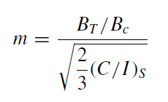
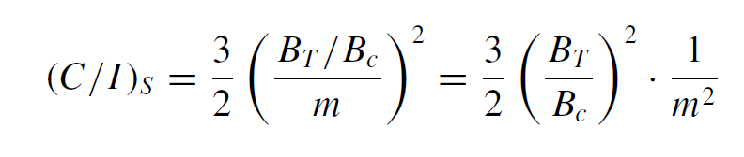
Relationship Among Capacity, Voice Quality, Dropped Call Rate
Radio Capacity m is expressed as follows:

Slide 46
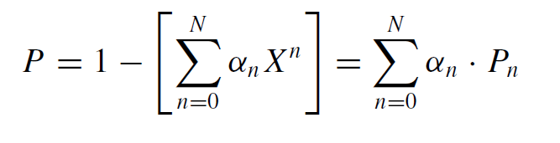
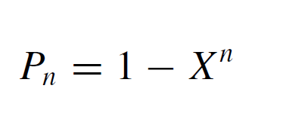
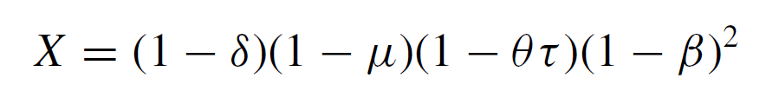
Formula of Dropped Call Rate
General Formula of Dropped Call Rate
The general formula of dropped call rate P in a whole system can be expressed as:
Where
And

Slide 47

Thank you………………

